Slide 1

PREDICTIVE ANALYSIS AND FORECASTING OF TRACK ATTRIBUTES
TEAM 2
Notes:
Esteemed members of the board, on behalf of the data analytics team at Spotify we welcome you to this debrief about the predicting of popularity in our song inventory and the forecasting of major attributes for the next 5 years.

Slide 2
TABLE OF CONTENTS
01
ASSUMPTIONS AND DATA PREP
Defining the goal of the analysis and reviewing the data
02
PREDICTIVE ANALYSIS
Binomial regression and GINI decision tree
03
FORECASTING MODEL
ARIMA model on the two most influential attributes for popularity
04
CONCLUSIONS
Business Insights and Recommendations
Notes:
For this presentation we will begin going through our assumptions for the creation of our predicting and forecasting models. Here we will talk about exclusions in our data. Then we will talk about our predictive models and their efficacy
Following that we will explain how we created our forecasting model Finally, we wrap up with our business insights and recommendations to the board.

Slide 3
01
Creating a model that predicts track popularity
Goals
Forecasting attribute values to adjust our revenue distribution algorithm
02
Notes:
To start our analysis we need to define the goals of our work. This is two-fold. First we look at track attributes to determine which ones are the most significant in determining a songs popularity. Then we look at the evolution of these attributes in time based on the release year of the songs analyzed and we forecast into the future for the next 5 years.

Slide 4
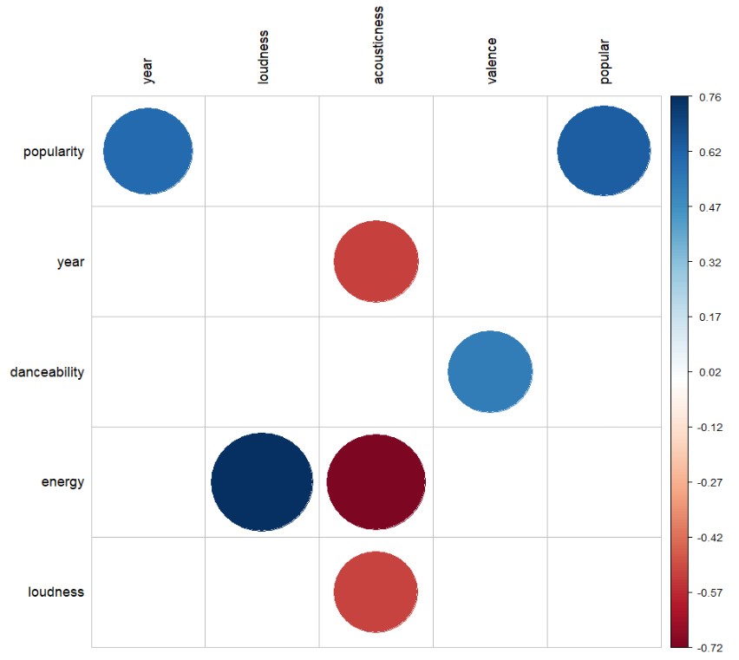
ASSUMPTIONS AND DATA PREPRATION
Analyzing the data:
No major outliers found
Time series of release years is consistent
Release month of the track, key, and tempo are insignificant, therefore excluded
Danceability is correlated to valence but not strongly enough to be excluded
Energy includes loudness and acousticness, therefore these variables are excluded
Graph 1. Correlations

Slide 5
PREDICTIVE ANALYSIS: MODELS
Logistic regression - statistical technique for predicting binary (0/1) outcomes by estimating the probability of an event occurring or not based on independent variables.
Coefficients are estimated to maximize the likelihood of observing actual outcomes in the training data.
Relies on coefficients to determine the importance of variables.
Offers insights into the likelihood of specific events.
Useful for data-driven decision-making.
Can be trained on historical data for prediction.
Offer different perspectives on the relationships between variables.
Provide valuable insights for managerial strategies.
GINI Decision Tree - algorithm used for classification and regression tasks and builds a structured representation of decision-making processes.
Captures complex interactions and relationships between variables.
Provides interpretability by visualizing the decision-making process.
Utilizes Gini impurity for optimizing the tree.

Slide 6
LOGIT MODEL (REGRESSION)
RESULTS
Accuracy: 88.57% <- level of how well our model predicts the correct outcomes of track becoming popular.
According to our model, the significant variables that influence the probability of track being popular:
For every increase in explicitness, the odd of tracks being popular increases by 166%​
For every increase in the rating for danceability, the odd of tracks being popular increases by 140%​
For every increase in speechiness, the odd of tracks being not popular increases by 76%​
For every increase in instrumentalness the odds of tracks being not popular increases by 62%​
For every additional minute of music, the odds of tracks being not popular increases by 2.2%
Confusion Matrix |  | Reference
 |  | 0 | 1
Prediction | 0 | 102 528 | 12 481
 | 1 | 931 | 1 395

Slide 7
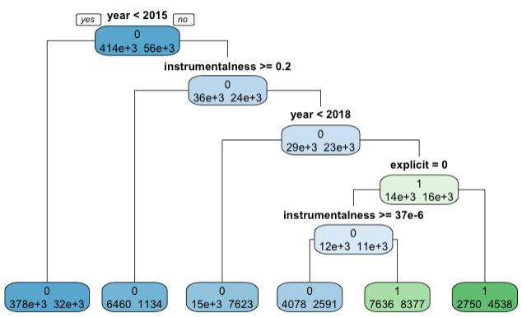
GINI DECISION TREE
RESULTS
Almost all tracks released earlier than the 2015 year and with instrumentallness >= 0.2 are not popular anymore
Accuracy: 88.71% - slightly better than logit model
Even though, the decision tree gives higher Type II error, the accuracy of the model is better, and it is better at catching non-linear dependencies between variables
Therefore, this model should be used by Spotify to predict future popular tracks
Confusion Matrix |  | Reference
 |  | 0 | 1
Prediction | 0 | 100 877 | 10 663
 | 1 | 2 582 | 3 213
Notes:
The sensitivity (true positive rate) is 0.9828, indicating a high proportion of correctly predicted popular songs.
But (true negative rate) is low at 0.1926, indicating a relatively high number of false positives.

Slide 8
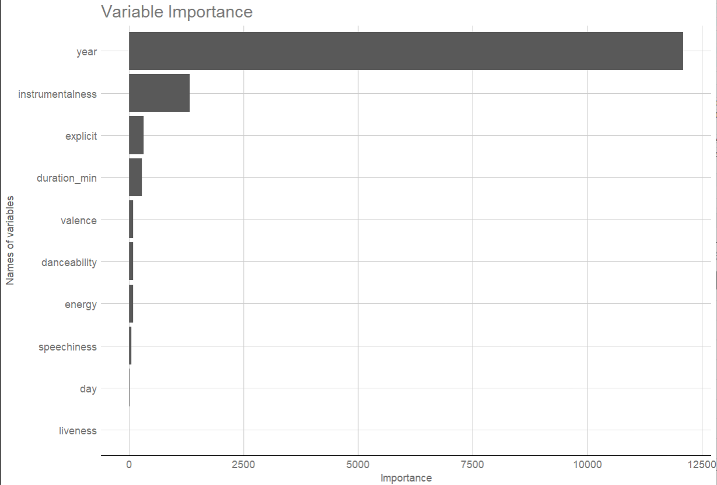
IMPORTANCE OF VARIABLES
The most important variables that indicate that they strongly influence the model's predictions are:
Year
Instrumentalness
Explicit
Duration in minutes
The least important variables that have the less impact on our model are:
Valence
Danceability
Energy
Speechiness
Day
Liveness
Notes:
After sorting all the variables, we have insights into which predictor variables are most influential in the decision tree model for business success.

Slide 9
WHICH MODEL DID WE CHOOSE?
The model used for the forecasting of our time series is the ARIMA model.
ARIMA (Autoregressive Integrated Moving Average) - time series forecasting model used to predict future values based on past observations.
We chose this model for the below-listed reasons:
Handle the non-stationarity of our time series.
Smoothen the noise and irregularities in the data.

Slide 10
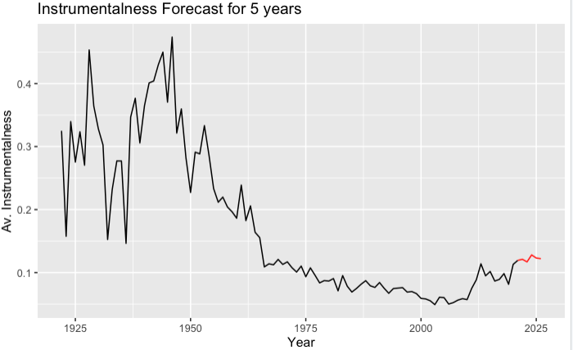
INSTRUMENTALNESS FORECAST
RESULTS
Following the instability in 1920-1962, there was a quick drop in the moving average over three years
From 1964 average instrumentalness became more stable with continuing downtrend
Nevertheless, average level of instrumentalness is expected to increase slightly in the next 5 years (by 0.8%)
Year | 2022 | 2023 | 2024 | 2025 | 2026
Predicted value | 0.121 | 0.117 | 0.128 | 0.123 | 0.122
INSIGHTS
Based on predictive models it means that fewer tracks will become popular as instrumentalness affects popularity in the negative way
Notes:
As one of the important variables, we concentrated our forecast on average instrumentalness

Slide 11
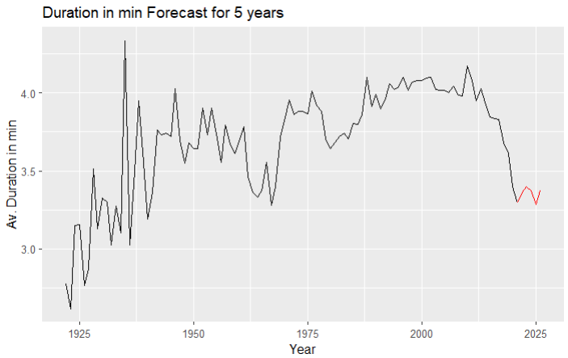
TRACK DURATION FORECAST
RESULTS
Duration of the songs does not have an obvious trend and fluctuates greatly through the observed period
It is expected for tracks’ average duration to increase by 3.1% in the next 2 years with slight fluctuation after
Overall increase in average duration in the next 5 years is expected to be 2.4%
Year | 2022 | 2023 | 2024 | 2025 | 2026
Predicted value | 3.364 | 3.397 | 3.375 | 3.284 | 3.375
INSIGHT
Based on predictive models it means that fewer tracks will become popular as duration is also decreasing the probability of a track becoming popular

Slide 12

CONCLUSIONS
Spotify should use GINI Decision Tree as a predicting model for tracks' popularity and adjust the payments to the artists based on the model results
Spotify should expect less tracks to be popular based on the forecasts of the average instrumentalness level and average duration of tracks, as they negatively affect the probability of song becoming popular

Slide 13





Thank you for your time
Diego Salinas
Polina Afanasyeva
Altynai Beishenalieva
Olubiyi George
Daniel Esteban Torres
TEAM 2

